Slide 1
Lexical Analysis

Slide 2
Lexical Analyzer – what does it do?
Read input characters from the source program
Create lexemes
Create tokens for each lexeme
Make an entry for a lexeme constituting an identifier
Keep track of that identifier in the token
Send the tokens to the parser

Slide 3
Lexical Analyser – scanning
Delete comments
Remove white spaces
Expand macros if used
Keep a record of new lines → facilitate the positioning of the error messages

Slide 4
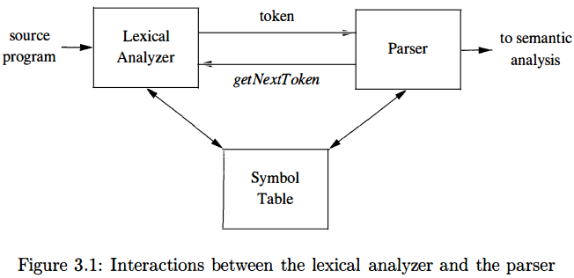
Interaction between Scanner and Parser
dragon book (Aho et al.)

Slide 5
Why not Parsers with Lexical analysers?
Simplicity of design
No comments
No unwanted whitespaces
Improved compiler efficiency
Apply specialized techniques suitable only for lexical task
Enhanced portability
Restricts the input-device-specific peculiarities

Slide 6
Tokens, Patterns and Lexemes
Token - <token_name, attribute value(optional)>
Pattern – description of the form that lexemes may take
Lexeme – sequence of characters in the source
Matches the pattern for a token
Instance of that token

Slide 7
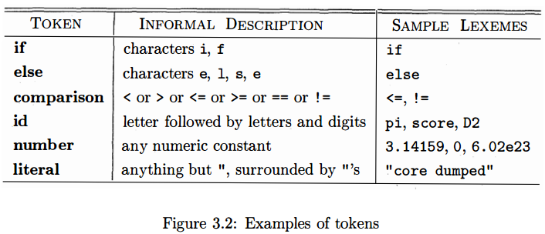
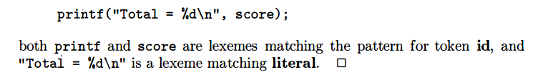
Example of tokens
keywords
operators
identifiers
constants
Punctuation symbols
dragon book (Aho et al.)

Slide 8
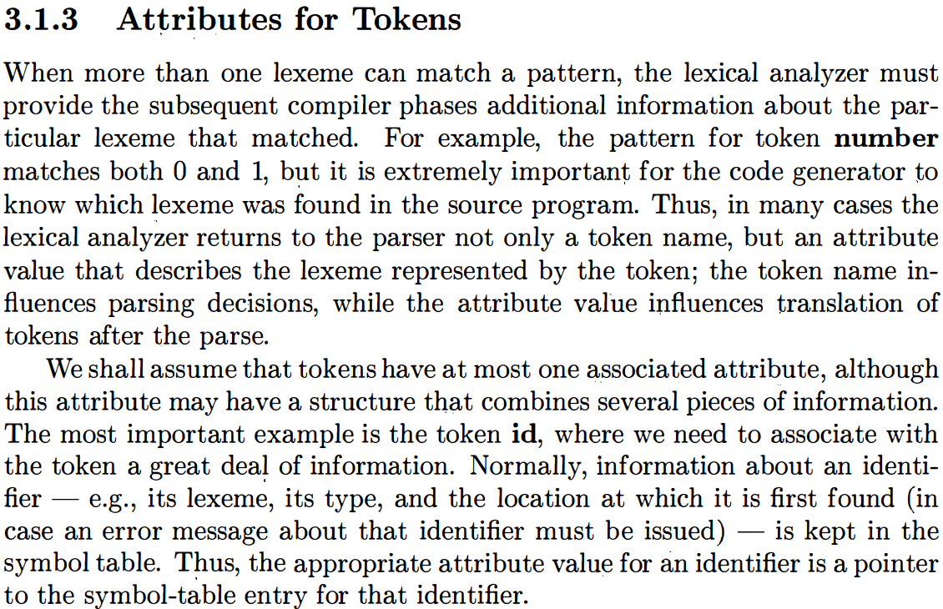

Slide 9
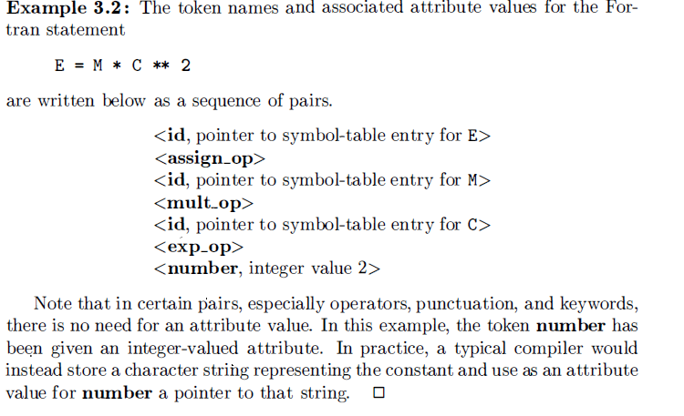
dragon book (Aho et al.)

Slide 10
End of part 1 Any questions??!!

Slide 11

Error recovery/handling
Mismatched pattern – unable to proceed
Misspelled if?
Or undeclared function identifier?
Panic mode recovery
Delete successive characters until a token is found
Delete one character
Insert a missing character
Replace one character by another character
Transpose to adjacent characters
Should carry on with fi as token and let some other phase to catch the error
Most lexical errors involve a single character

Slide 12
Input buffering
= or ==
> or >=
if or i,f
Therefore, reading one character is not enough
Again, how far should we scan?

Slide 13
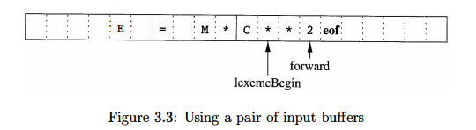
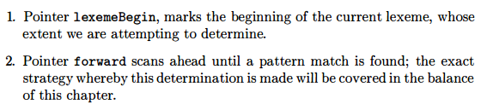
Buffer pairs
dragon book (Aho et al.)

Slide 14
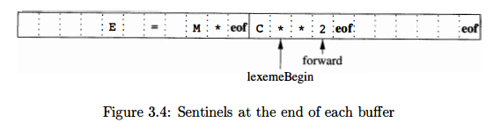
Sentinels
dragon book (Aho et al.)

Slide 15
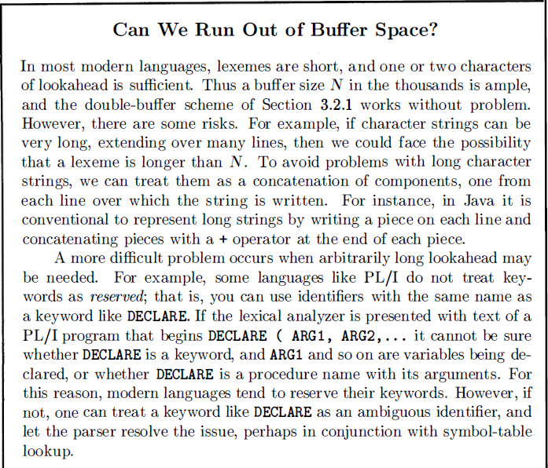
dragon book (Aho et al.)

Slide 16
Some Notations
Alphabet – a finite set of symbols
Letters, digits, punctuations etc
{0,1} – binary alphabet
String – a finite sequence of symbols drawn from an alphabet
String s - its length |s|
ε – empty string ( length 0)
Language – countable set of strings over some fixed alphabet

Slide 17
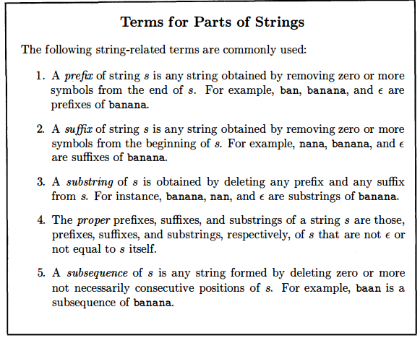
dragon book (Aho et al.)

Slide 18
More on Strings
Concatenation
xy → for strings x and y
x = dog, y = house → xy = doghouse
sε = εs = s
Exponentiation
s⁰ = ε
s² = ss
s³ = sss

Slide 19
Language Operators
Union (L U M)
String either in L or in M – set of strings of length 1
Concatenation (LM)
First string from L, the second string from M – set of strings of length 2
Closure
Kleene closure (L*) - set of all strings obtained from concatenating L 0 or more times (including ε)
Positive closure (L⁺) – set of all strings obtained from concatenating L 1 or more times (without ε)

Slide 20
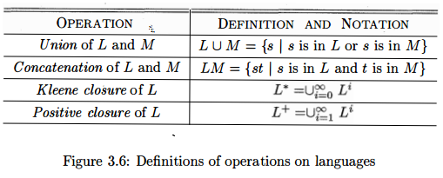
Language operators – formal definition
dragon book (Aho et al.)

Slide 21
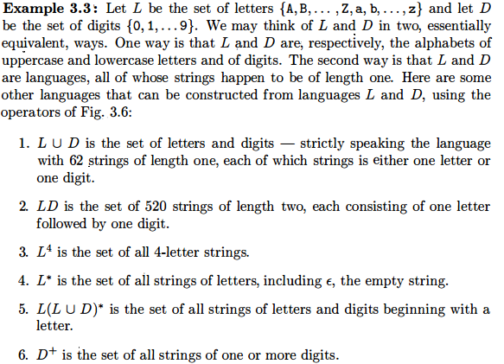
Example
dragon book (Aho et al.)

Slide 22


Regular expressions
Sequence of characters forming a pattern
e.g. example 3.3
→ set of C identifiers
Built recursively out of smaller expressions
Rules
dragon book (Aho et al.)

Slide 23
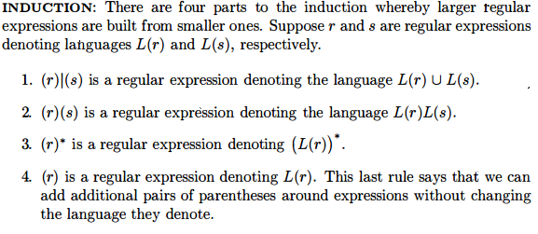
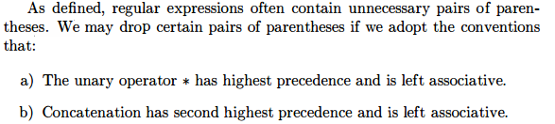
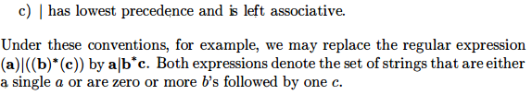
dragon book (Aho et al.)

Slide 24
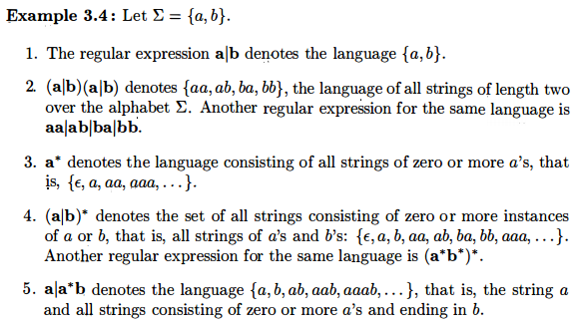
Example
dragon book (Aho et al.)

Slide 25
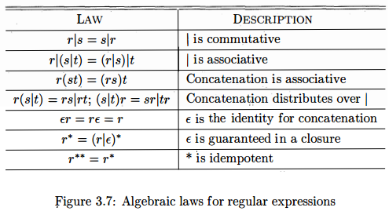
Algebraic Laws for Regular Expressions
dragon book (Aho et al.)

Slide 26
End of Part 2

Slide 27
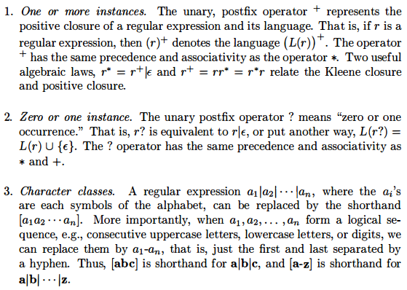
Extensions of Regular Expressions
+ VS ?
dragon book (Aho et al.)

Slide 28

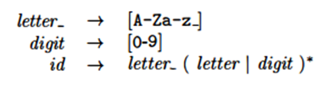
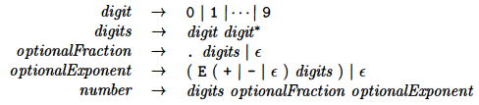

Example 3.5
Example 3.7
Example 3.6
Example 3.7
dragon book (Aho et al.)

Slide 29
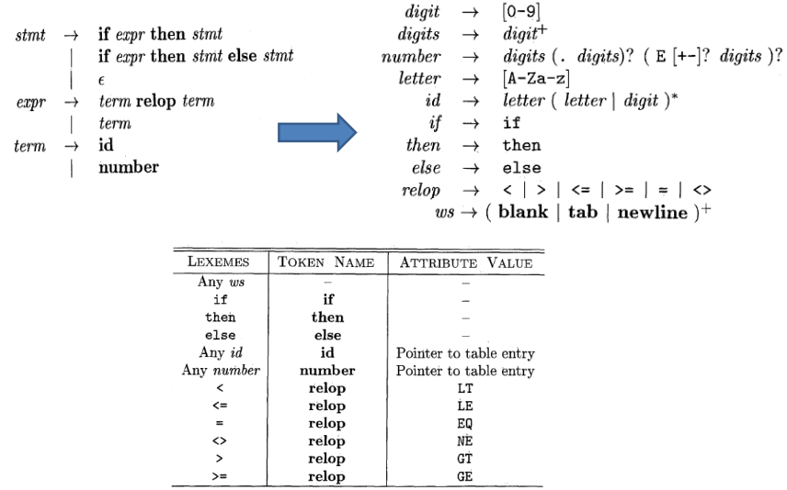
Tokens Recognition
Keywords
Reserved Words → not an id
Are not returned to the parser
Example 3.8 – Aho book

Slide 30
Transition Diagrams
Pattern →Stylised flow chart → Lexical Analyser
Intermediate step
Nodes or Circles → states
Edges → transition from one state to another
Labeled by symbols
Transition Diagram

Slide 31
Finite Automata State Graphs
A state
The start state
start
*
An accepting state
a
A transition

Slide 32
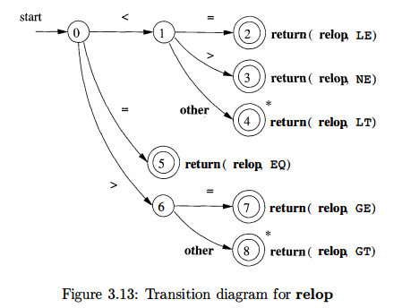
Example (3.9)
Final/Accepted state
Actions Associated with the final state
Retract the Forward Pointer

Slide 33

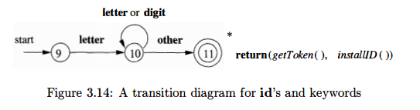

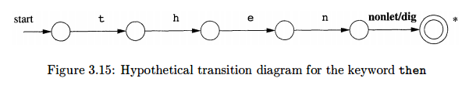
Keywords/ID recognition

Slide 34
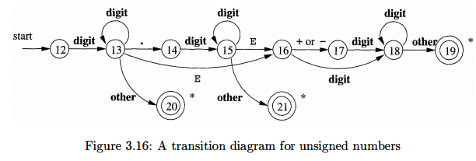
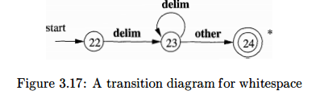
Unsigned Number & White Space Recognition

Slide 35
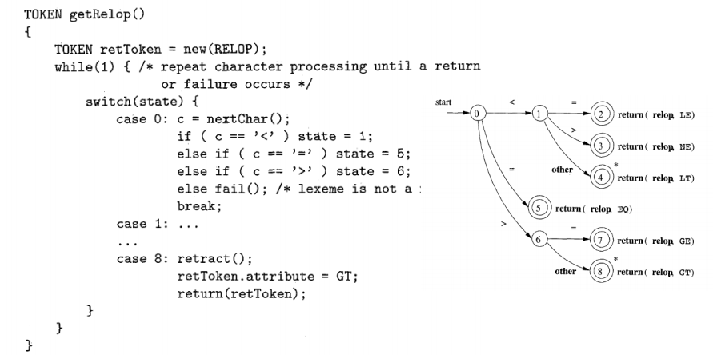
Implementation of Transition Diagram

Slide 36
End of Part 3

Slide 37
Finite Automata
Graph → like transition diagram, however
Recognizer → Yes or No
and
2 types
NFA (Nondeterministic Finite Automata)
no restriction on the edges for one symbol and ε i.e. empty string is possible
DFA (Deterministic Finite Automata)
exactly one edge out of one state with one symbol

Slide 38
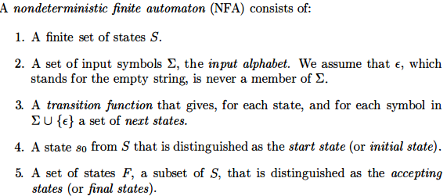
NFA

Slide 39
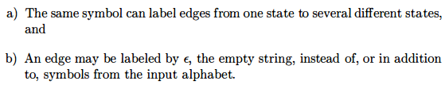
Representation of an NFA
An NFA can be represented by a Graph which is very much like a transition diagram. However,

Slide 40
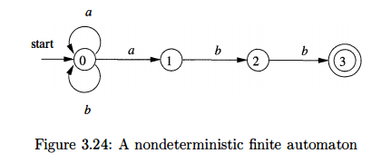
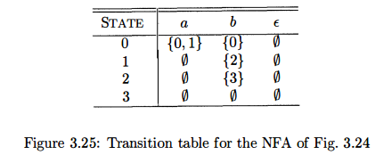
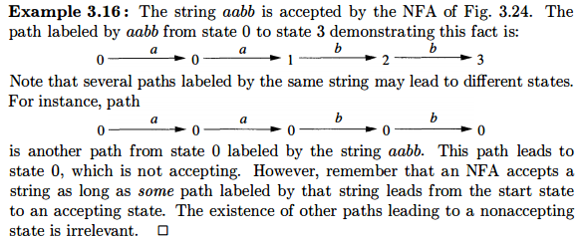
NFA and Transition Table
Some accepted strings:
aabb, ababb, ababaaabb etc…
Takes a lot of space

Slide 41
DFA
A special case of NFA where
There are no ε moves
Only 1 transition from one state with one symbol
NFA → abstract representation
DFA → simple, concrete algorithm
Every regular expression and every NFA can be converted to a DFA

Slide 42
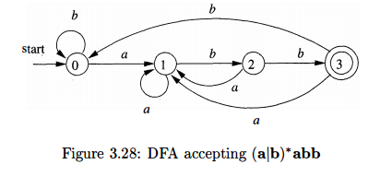
Example of DFA

Slide 43
NFA to DFA

